Slide 1
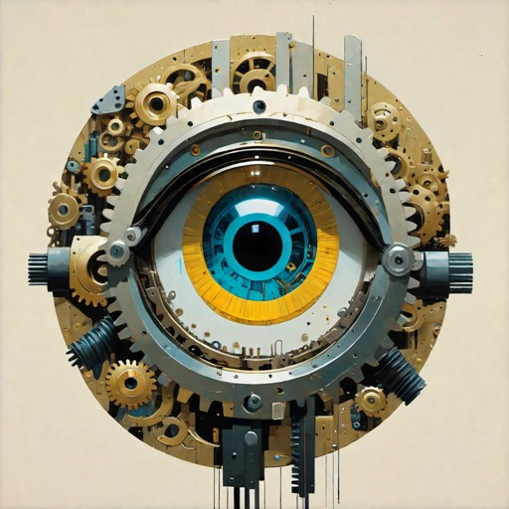
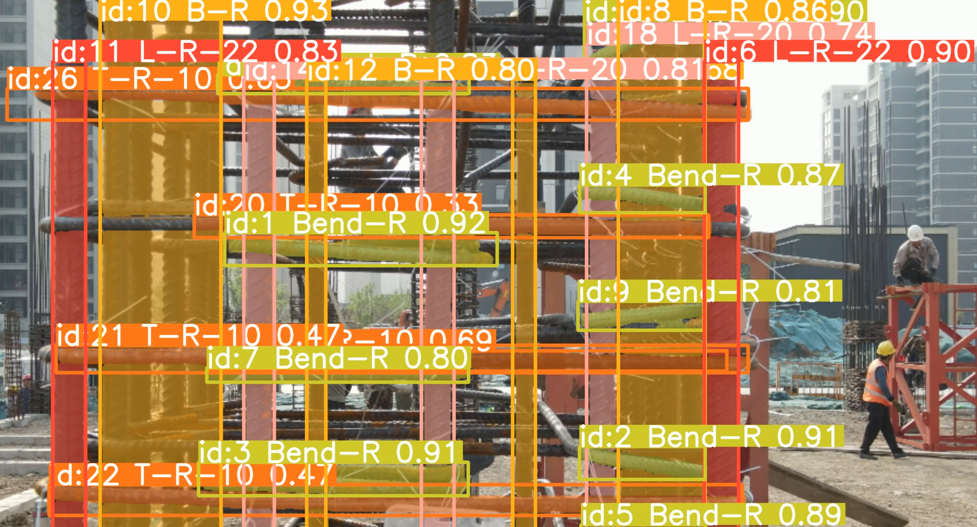
Your
Logo
Rebar monitoring by computer vision: A prototypical implementation and evaluation
Xingying Li Computer Science
Zonghai Yang Civil Engineering
29/05/2024
Research Driven Project

Slide 2
Your
Logo
Research Questions
Notes:
What is it that we are doing?

Slide 3


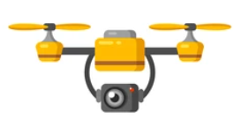
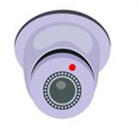
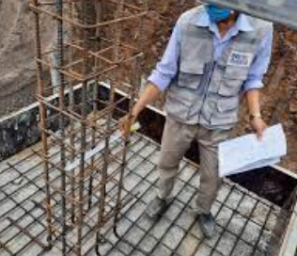

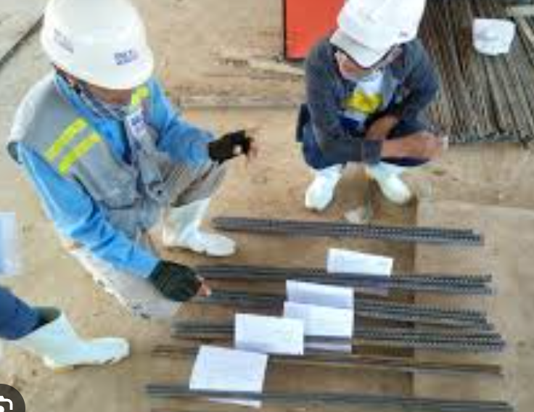
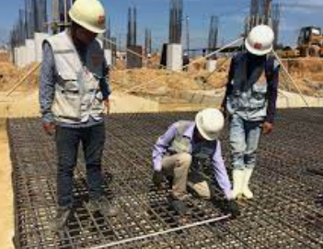
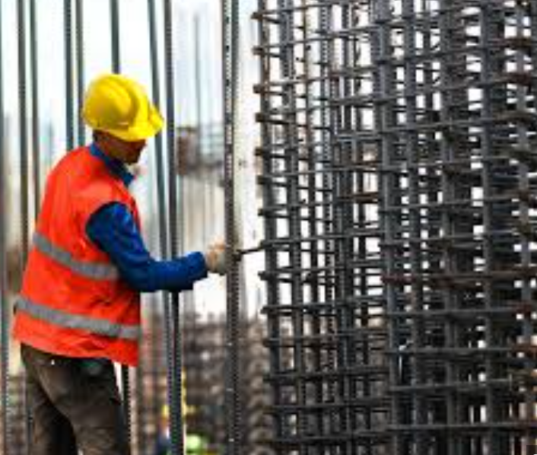
Research questions.
Input routes and standards
Analyse Output
*CV, Management Control
Offer assistance
*Alert and record
Can the real-time detection model YOLO identify stirrups, longitudinal bars, and other reinforcements tied to columns and beams?
With the addition of segmentation and tracking layers, can YOLO analyze area and count information?
Can YOLO recognize the relative positions of stirrups or longitudinal bars in 3D space?

Slide 4
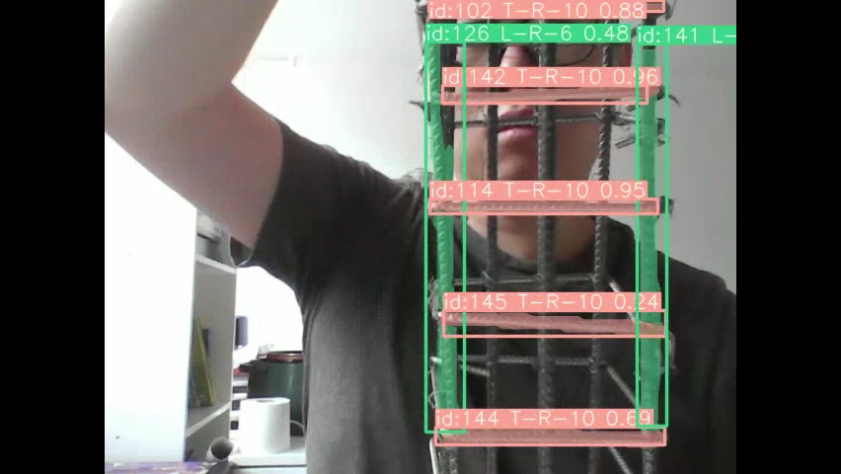
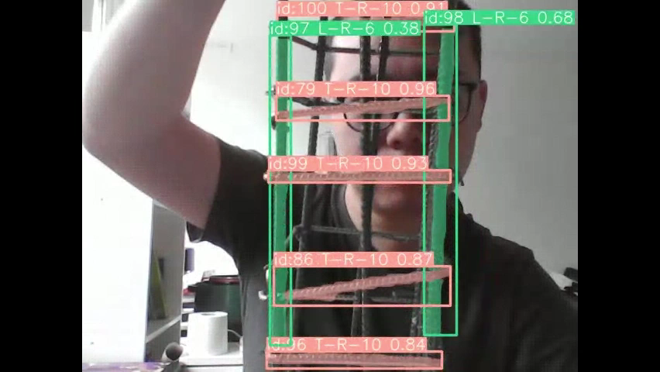
Prototype Results
3d-feature recognition
Model catched 3d-feature
Model missed 3d-feature
Fig1: Injuries in Europe construction

Slide 5
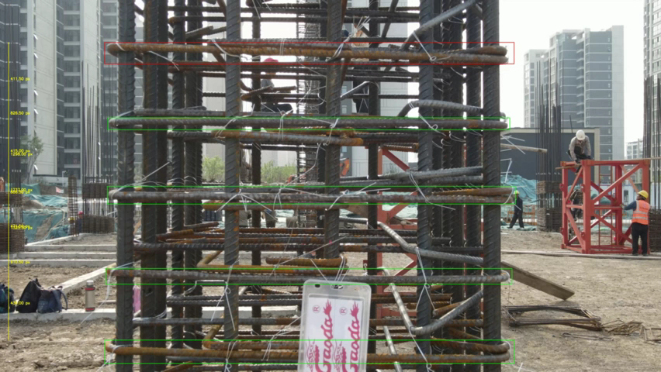
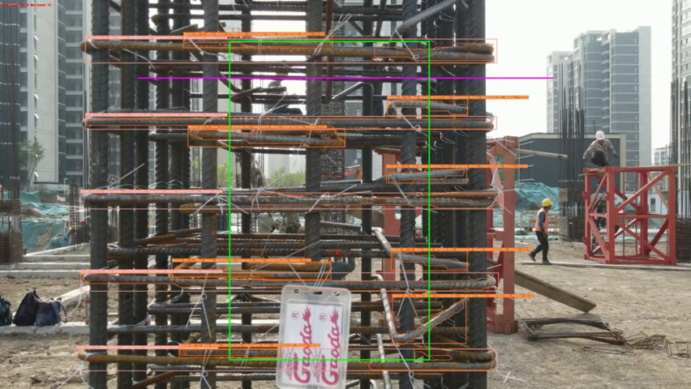
Prototype Results
Distance-Results-Video
Counting-Results-Video
Fig1: Injuries in Europe construction

Slide 6
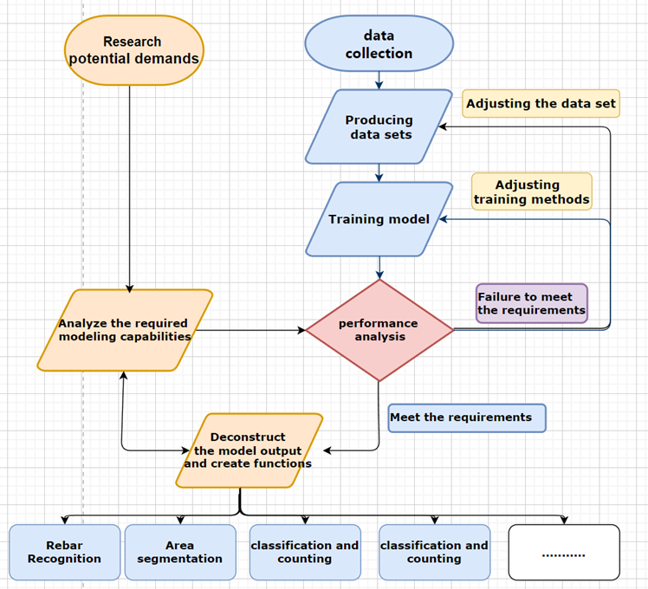
Prototype Process
Fig1: Injuries in Europe construction

Slide 7
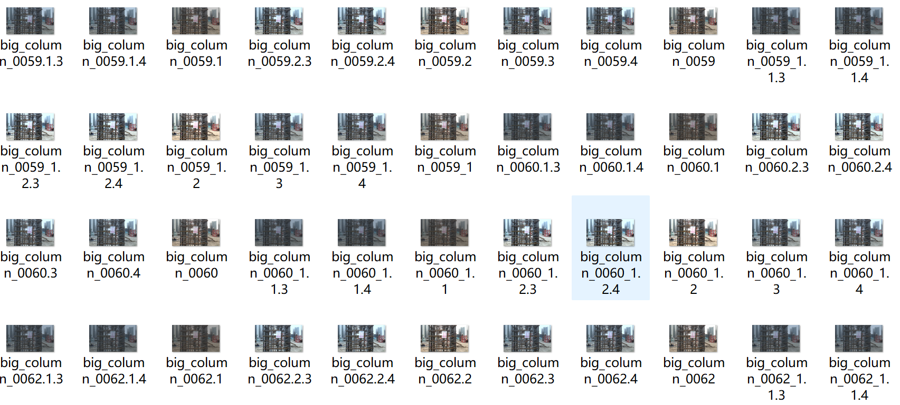
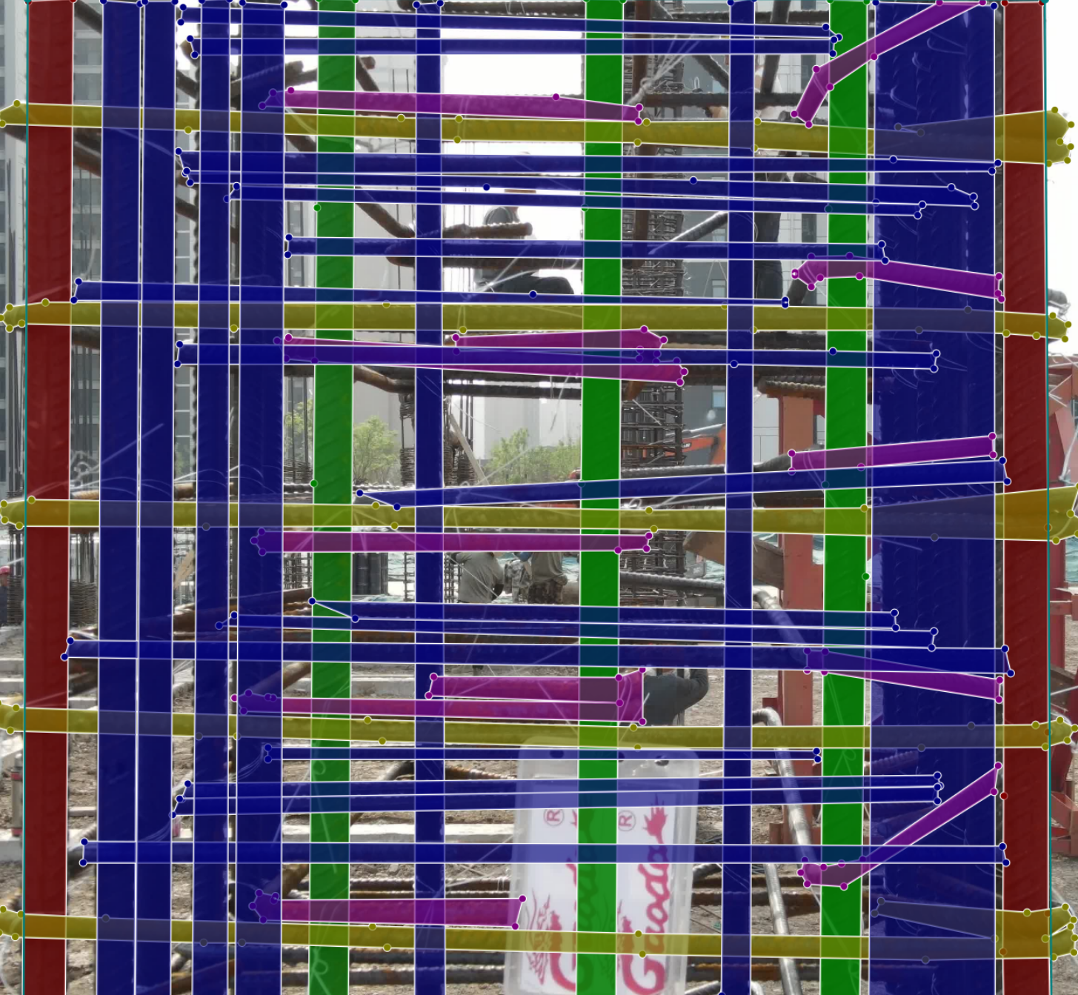
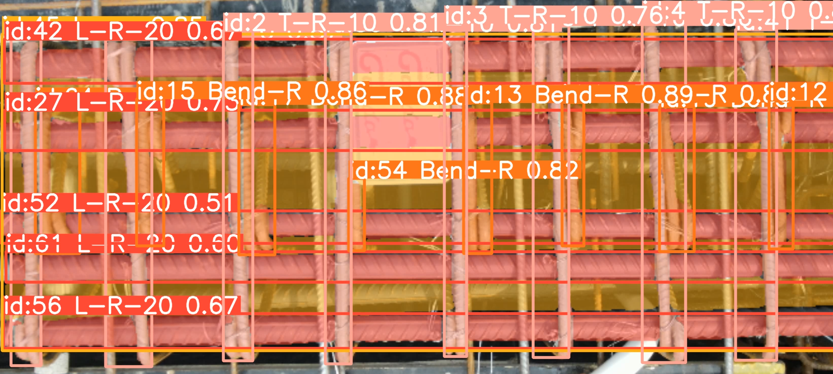
Research Process - Modeling Training
expanding the dataset
And tuning hyperparameter
Data collation and labeling
Analysis Model performance
Fig1: Injuries in Europe construction

Slide 8
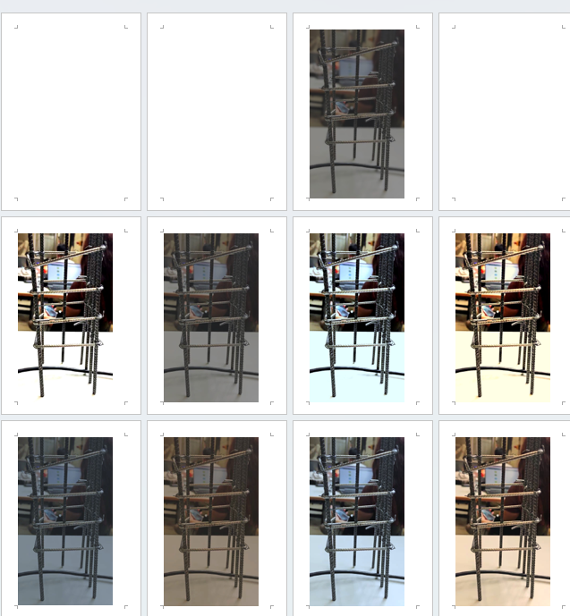
Research Results Analysis - Modeling Training
Data collation and labeling
By labeling the same type of rebar located in the background as "back-ground," we enabled the model to recognize the 3D position and identify the rebar in the foreground.
Expanding the dataset and tuning hyperparameter
By altering the brightness, color temperature, and modifying the backgrounds , we expanded 60 images to 1700 images and result in a better analysis output.
Analysis Model performance
Overfitting due to the limited column types and high distinguishability of rebar in our handmade models.

Slide 9
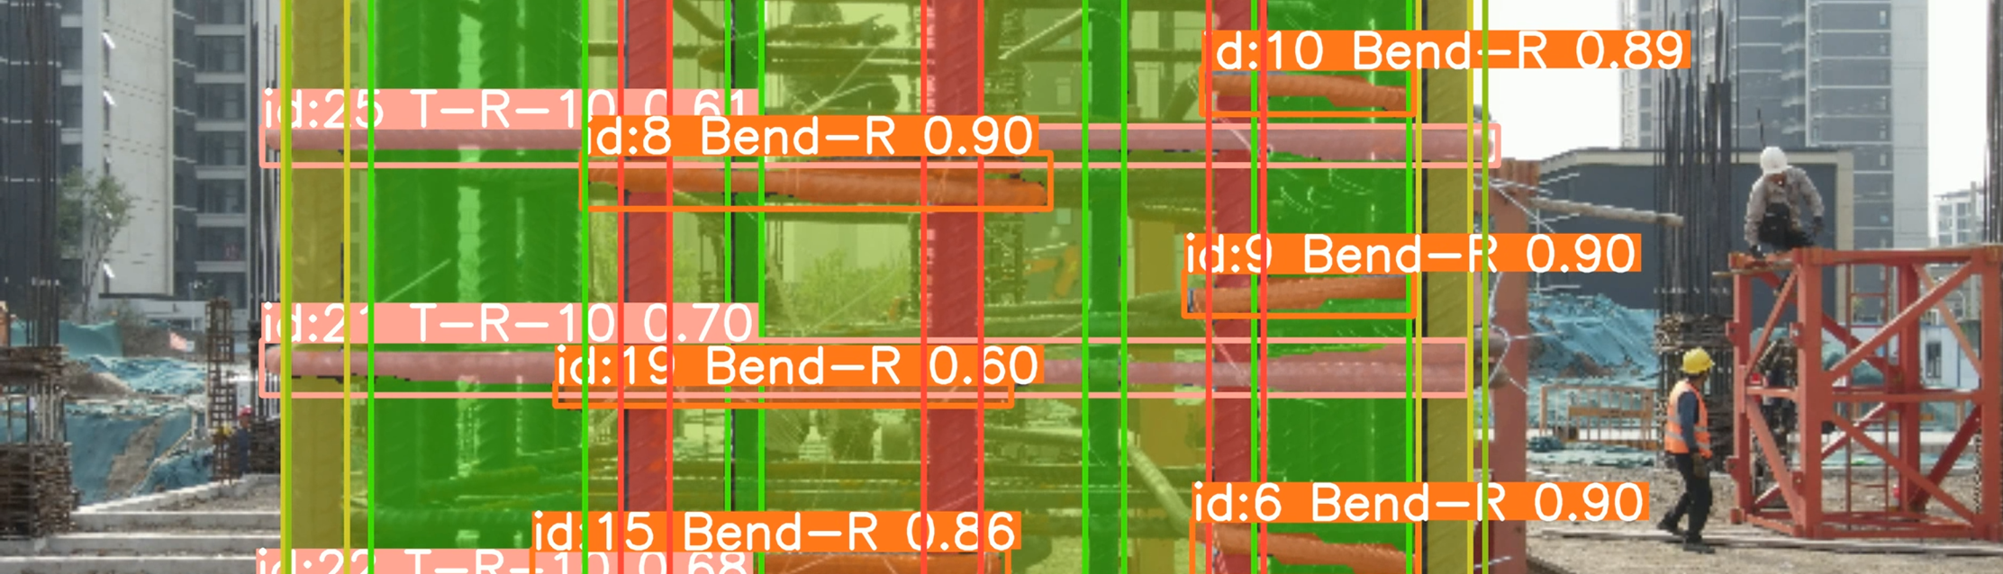
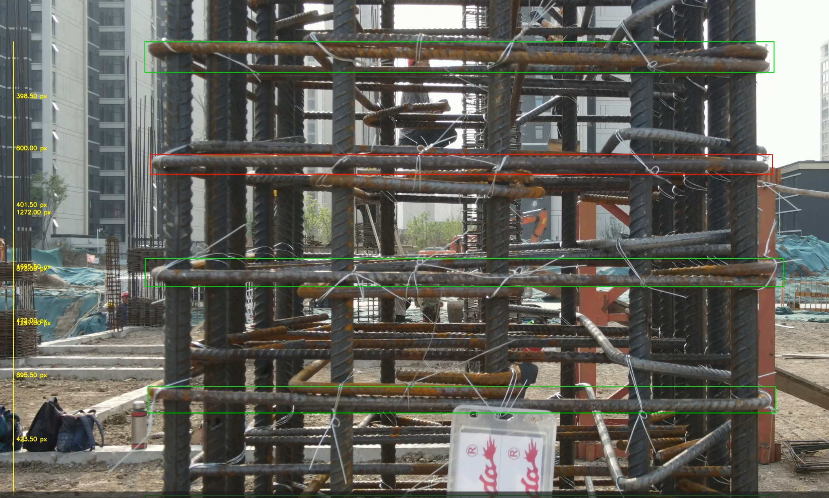
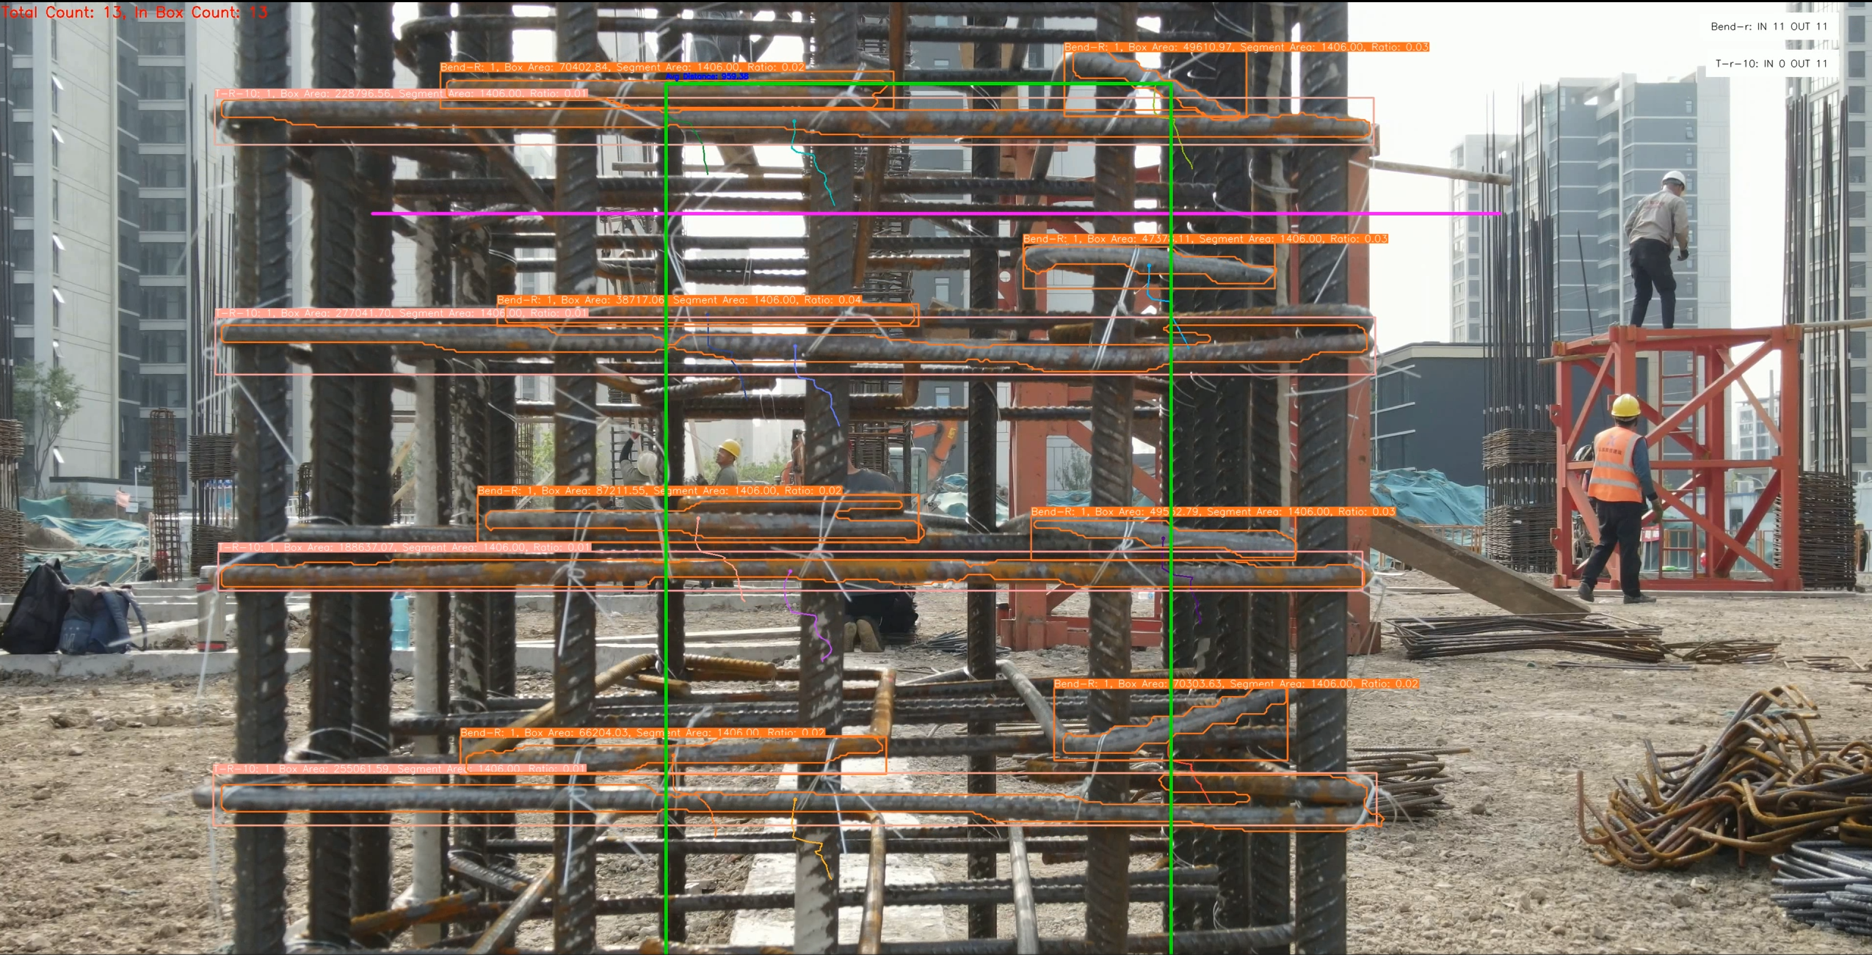
Research Results Analysis – Model Output
Bounding boxes with class-specific annotations
Distance-Results
Annotation
Fig1: Injuries in Europe construction

Slide 10
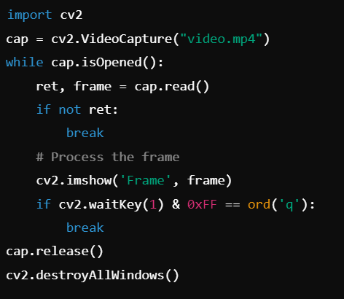
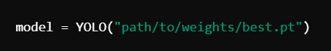
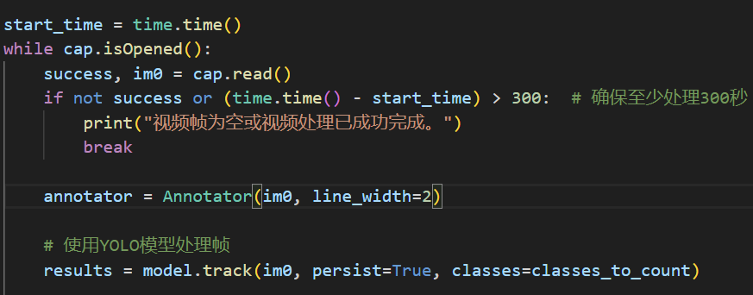
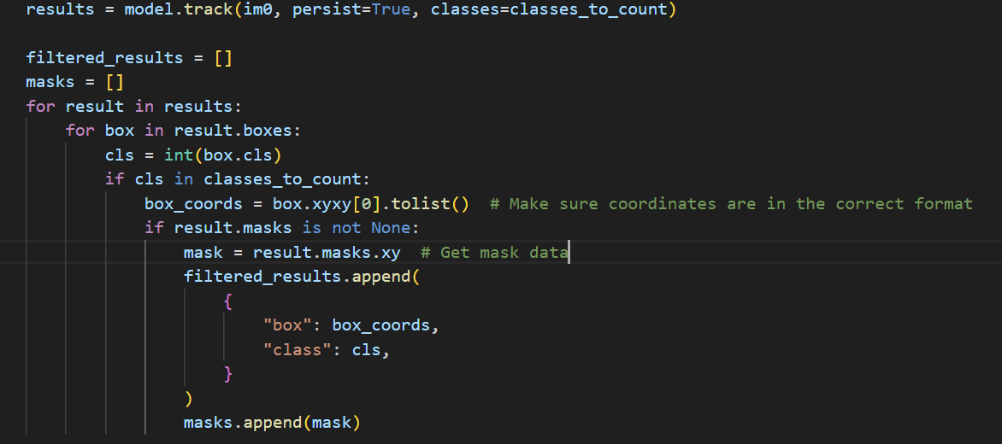
Computer Vision Models and Methods Used (1)
YOLOv8 Model
OpenCV for Video Processing
YOLOv8 Model Initialization
Video Capture
Frame Extraction and Annotation
Real-time Object Detection
Fig1: Injuries in Europe construction

Slide 11
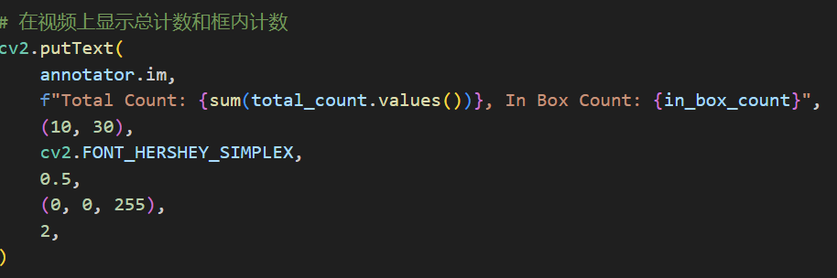
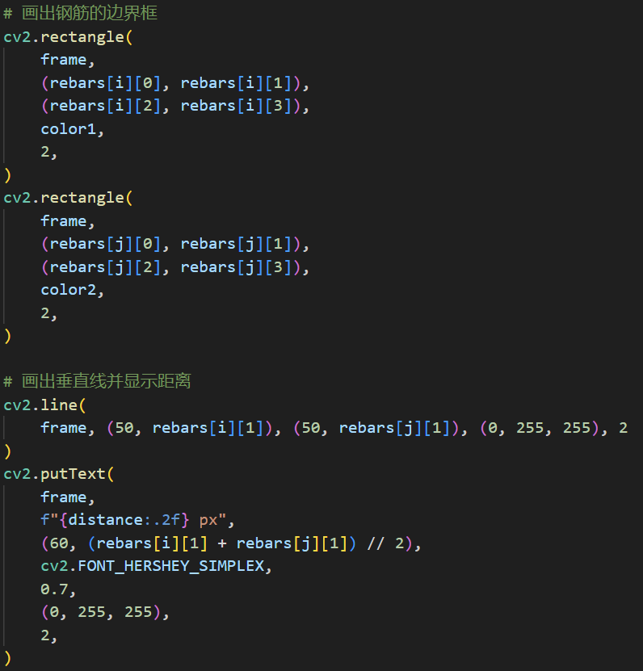
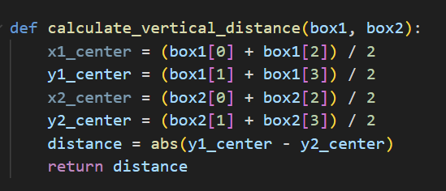
Computer Vision Models and Methods Used (1)
Object Counting and Distance Calculation
Annotation and Visualization
Object Counting
Bounding Boxes and Class Annotations
Distance Calculation
Fig1: Injuries in Europe construction

Slide 12
Open-source &
Hardware components
Your
Logo
Notes:
What is it that we are doing?

Slide 13
Open-source and tools
Sources:
Yolov8
https://docs.ultralytics.com/ Real-time object detection
Segment Anything
https://segment-anything.com/ Image segmentation
Label me
http://labelme.csail.mit.edu/Release3.0/ Image annotation
BoT-SORT
https://github.com/NirAharon/BoT-SORT/ Object tracking in video
FFmpg
https://ffmpeg.org/ Multimedia processing

Slide 14
Your
Logo
Outlook
Notes:
What is it that we are doing?

Slide 15
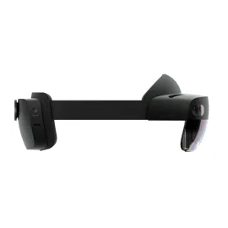
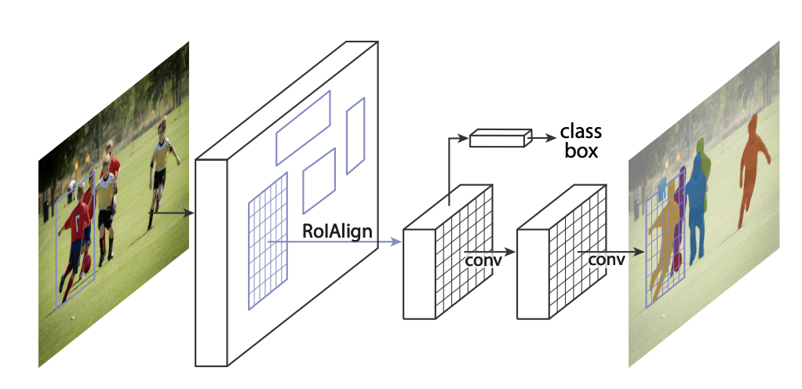
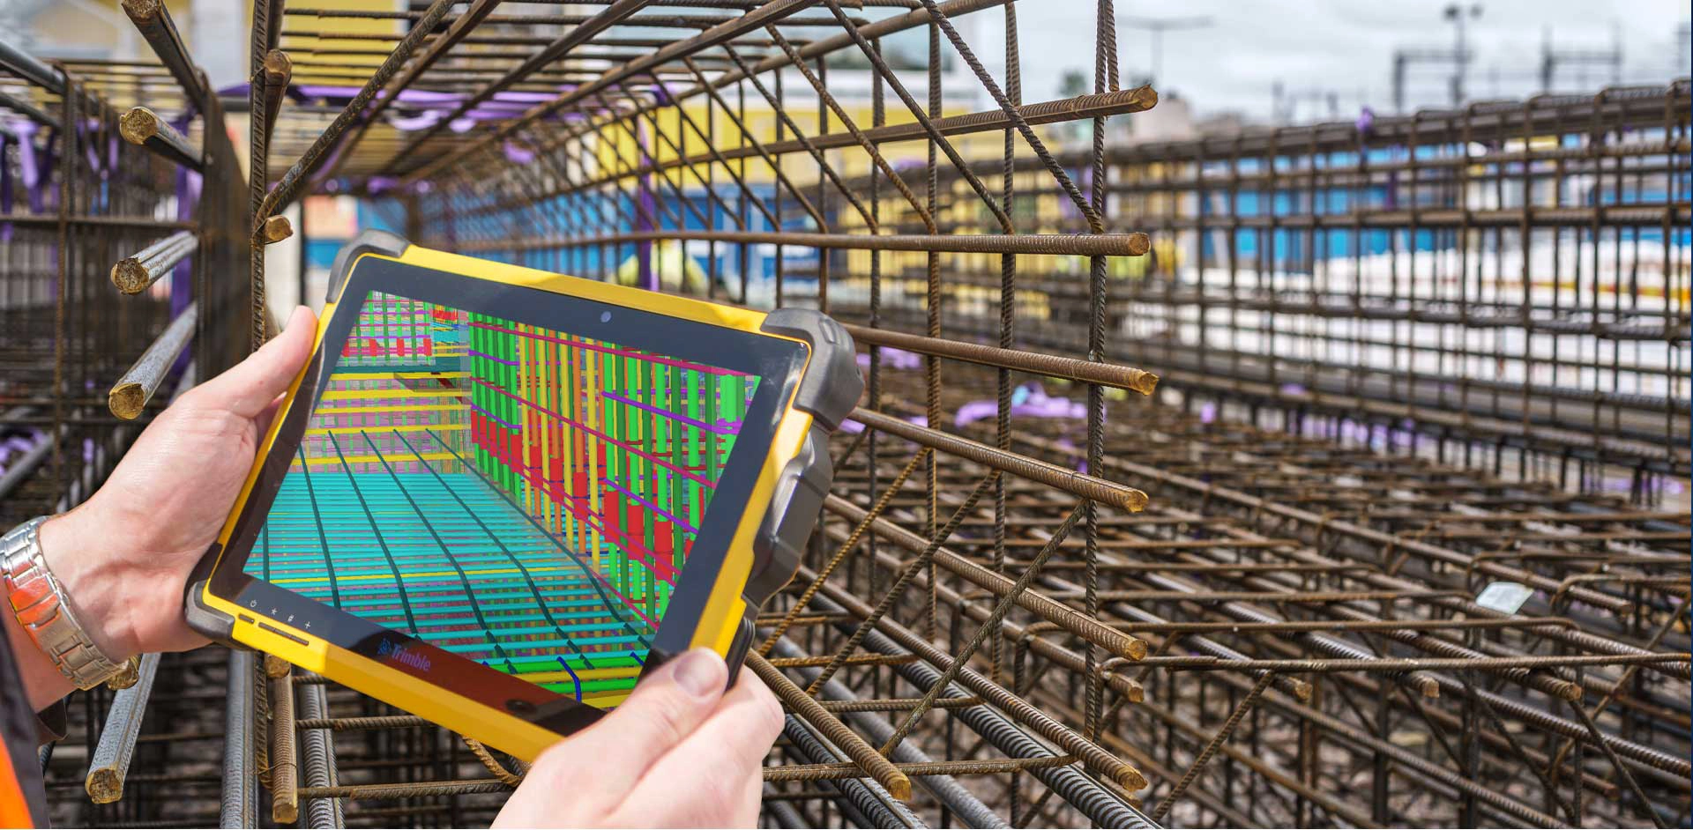
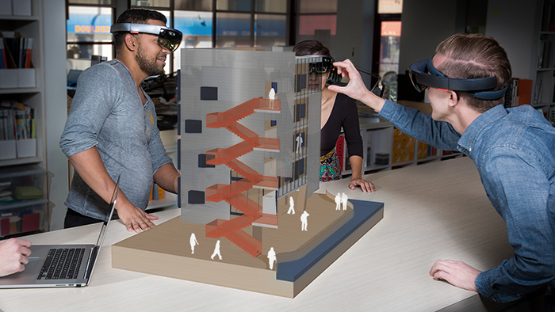
Expansion at the hardware and software level
Software
Hardware
Mask R-CNN
BIM
Cloud-based
AR
Edge Computing Devices
4K Resolution Cameras

Slide 16
Prototyping procedure & Schedule
Your
Logo
Notes:
What is it that we are doing?

Slide 17
What’s next?
Data collection (video, pictures)
Train/test our model
Output Analysing
Prototyping procedure & Schedule
29.05.2024 Mid Colloquium | 05.06.2024 | 12.06.2024 | 19.06.2024 | 26.06.2024 | 03.07.2024 | 10.07.2024 | 17.07.2024 | 14.08.2024 Final Colloquium
Presentation our goal.
 | Making some research about CV.
 |  |  | Start programing
 |  |  |  |  | Collect data (videos, images)
 |  |  |  |  |  | Train and test the data in our model
 |  |  |  |  |  |  |  | COMPLETED.

Slide 18
Any Questions ?
Notes:
What is it that we are doing?

Slide 19
References
Fig1:https://ieeexplore.ieee.org/stamp/stamp.jsp?arnumber=9075243
Fig2:Numan Khan, Syed Farhan Alam Zaidi, Jaehun Yang, Construction Work-Stage-Based Rule Compliance Monitoring Framework Using Computer Vision (CV) Technology
Fig3: Numan Khan, Syed Farhan Alam Zaidi, Jaehun Yang, Construction Work-Stage-Based Rule Compliance Monitoring Framework Using Computer Vision (CV) Technology
Fig4: https://viso.ai/applications/computer-vision-in-construction/
Fig5: https://viso.ai/applications/computer-vision-in-construction/
Fig6: https://docs.ultralytics.com/
Fig ‘manual entry’ & ‘Problems’ : https://files.oaiusercontent.com/
Fig ‘re-examinations’ :https://www.reinforcing-bar.com/img/check-reinforcing-steel-bars-spacing.jpg
Fig ‘Mask R-CNN’:https://paperswithcode.com/method/mask-r-cnn
Fig ‘BIM’:https://www.tekla.com/resources/home/taking-your-rebar-detailing-to-the-next-level-with-the-newest-tekla-2020-and-the-new-rebar-elearning
Fig ‘AR’ and ‘Hololens’:https://aecmag.com/news/news-trimble-unveils-sketchup-viewer-for-microsoft-hololens/ &https://www.microsoft.com/de-de/d/hololens-2-industrial-edition/8mqn5pzp01x5?activetab=pivot:%C3%BCbersichttab

Slide 20

The power points ends here

